Slide 1
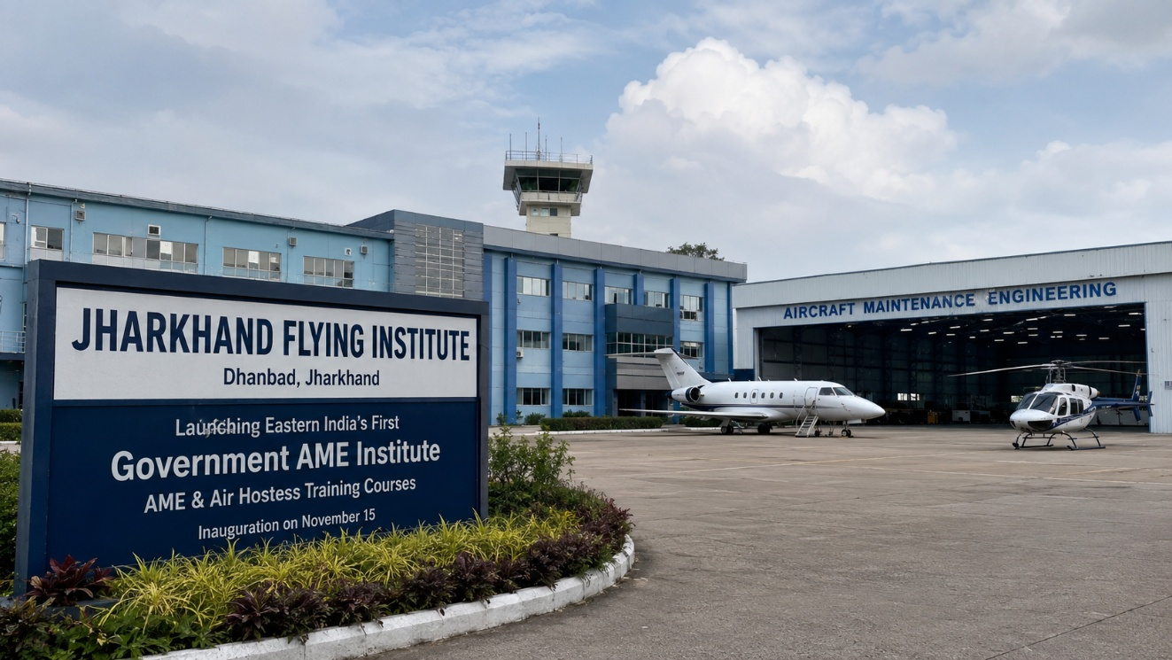
JHARKHAND
FLYING INSTITUTE
AIRCRAFT MAINTENANCE ENGINEERING (AME)
ENGINEERING THE PEOPLE
WHO KEEP AVIATION FLYING.
DGCA CAR-147 • B1.2 • B2 • COMBINED • TYPE TRAINING
2 + 2 YEARS
DHANBAD
JOINT VENTURE
Theory + Practical OJT
Airport-based ecosystem
Vanour Air Pvt Ltd
ADMISSIONS 2026

Slide 2
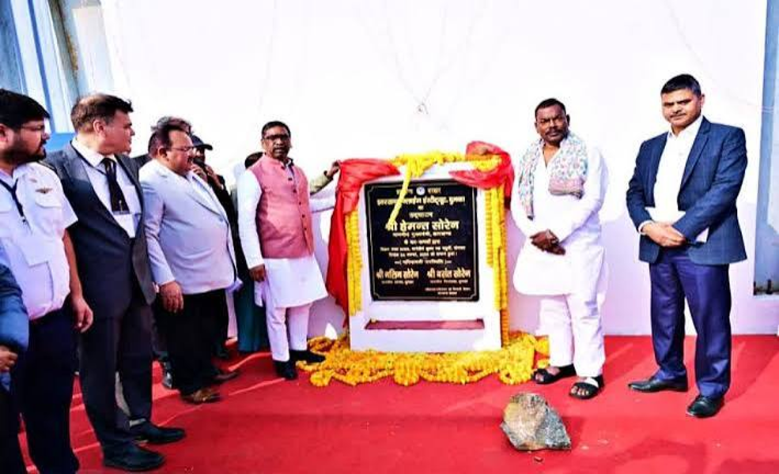
VISION
02
BUILDING THE NEXT GENERATION OF AVIATION ENGINEERS
ONE ROOF. ONE AVIATION ECOSYSTEM.
Jharkhand Flying Institute’s AME initiative combines classroom learning, practical training and industry exposure, with a focus on making aviation education accessible to talented students from smaller towns and rural areas.
VISION
Position Jharkhand as a major Civil Aviation Educational Hub.
TRAINING MODEL
Two years of theoretical classroom coursework followed by two years of practical, on-the-job training.
JHARKHAND FLYING INSTITUTE (AME) • VANOUR AIR PVT LTD
DHANBAD • JHARKHAND

Slide 3
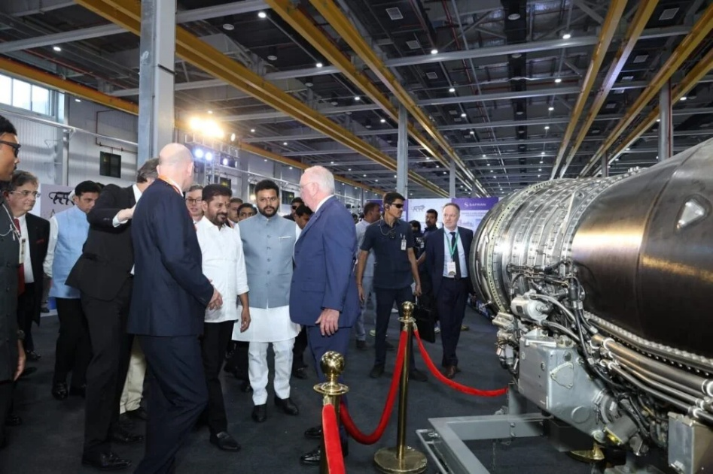
MARKET OPPORTUNITY
03
AVIATION GROWTH CREATES A NEED FOR SKILLED AMEs
The uploaded material highlights rapid fleet growth and a corresponding need for licensed aircraft maintenance professionals.
800+
2,250
MRO
Commercial aircraft referenced in the brochure’s growth outlook
Aircraft scale projected over the next decade in the source material
Growing maintenance, repair & overhaul ecosystem
ENGINEERS NEEDED
CAREER ECOSYSTEM
Every new commercial aircraft requires skilled, licensed professionals to maintain operational safety.
Commercial airlines • MRO organizations • Civil aviation departments.
JHARKHAND FLYING INSTITUTE (AME) • VANOUR AIR PVT LTD
DHANBAD • JHARKHAND

Slide 4
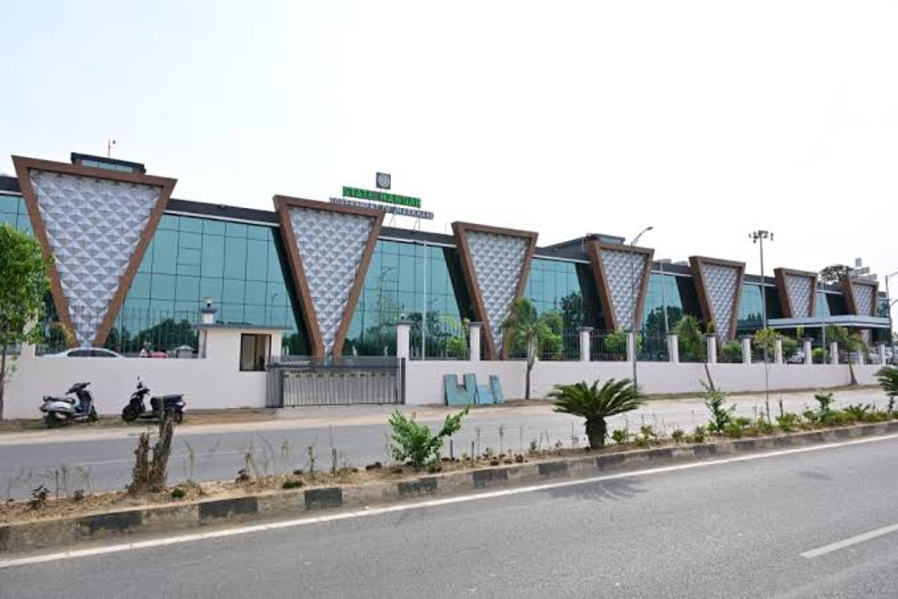
WHY JHARKHAND FLYING INSTITUTE?
A PRACTICAL, INDUSTRY-ORIENTED PATH
FROM BASIC TRAINING TO TYPE TRAINING
• B1.2 AME pathway focused on aeroplanes piston
• B2 pathway focused on avionics
• Combined B1.2 + B2 option
• Optional dual-degree B.Tech programme mentioned in the source
• Type-rating training and licence endorsement pathways
BUILT AROUND AVIATION’S TECHNICAL WORKFORCE NEEDS
JHARKHAND FLYING INSTITUTE (AME) • VANOUR AIR PVT LTD
DHANBAD • JHARKHAND

Slide 5
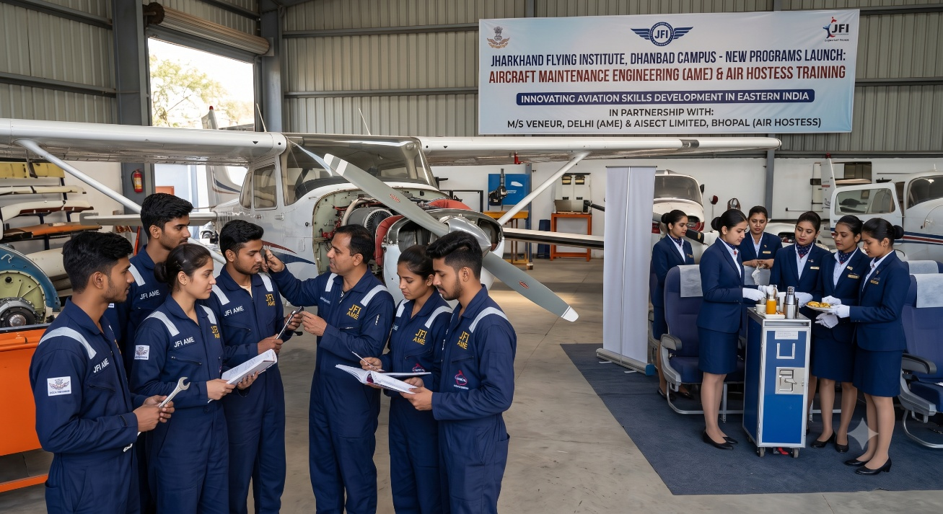
PROGRAMME
05
A STRUCTURED PATH FROM KNOWLEDGE TO AIRCRAFT-SPECIFIC SKILLS
01
02
03
04
CAR-147 BASIC
→
CAR-66 MODULES
→
CAR-145 MRO
→
TYPE TRAINING
Basic knowledge + practical training
Structured regulatory curriculum
Practical maintenance exposure
Aircraft-specific skills & endorsements
B1.2
B2
COMBINED
Aeroplanes Piston
Avionics
B1.2 + B2
JHARKHAND FLYING INSTITUTE (AME) • VANOUR AIR PVT LTD
DHANBAD • JHARKHAND

Slide 6

HANDS-ON LEARNING
06
LEARN THE THEORY. SEE THE SYSTEMS. UNDERSTAND THE AIRCRAFT.
PRACTICAL EXPOSURE IS CENTRAL TO THE STORY
LIVE-AIRCRAFT ENVIRONMENT
The uploaded brochure highlights practical maintenance experience within the training ecosystem.
MRO INTEGRATION
The programme material describes a DGCA CAR-145 approved MRO link for practical exposure.
MODERN LABS & WORKSHOPS
The uploaded brochure’s official-information section highlights modern labs and workshops.
JHARKHAND FLYING INSTITUTE (AME) • VANOUR AIR PVT LTD
DHANBAD • JHARKHAND

Slide 7
ADMISSIONS
07
WHO CAN APPLY?
10+2
50%
16+
MEDICAL
FITNESS
PCM from recognized board
Minimum aggregate in PCM
Minimum age at admission
MBBS doctor certificate
No color blindness + general fitness
FINANCIAL OVERVIEW
APPROX. INR 5.5–7.5 LAKHS
ADDITIONAL EXPENSES
FINANCING ROUTES
Foundational training segment • depends on course category
Living, personal insurance and travel during external shifts are separate.
The brochure mentions government schemes, industry cadet programmes and government bank loan facilities.
JHARKHAND FLYING INSTITUTE (AME) • VANOUR AIR PVT LTD
DHANBAD • JHARKHAND

Slide 8
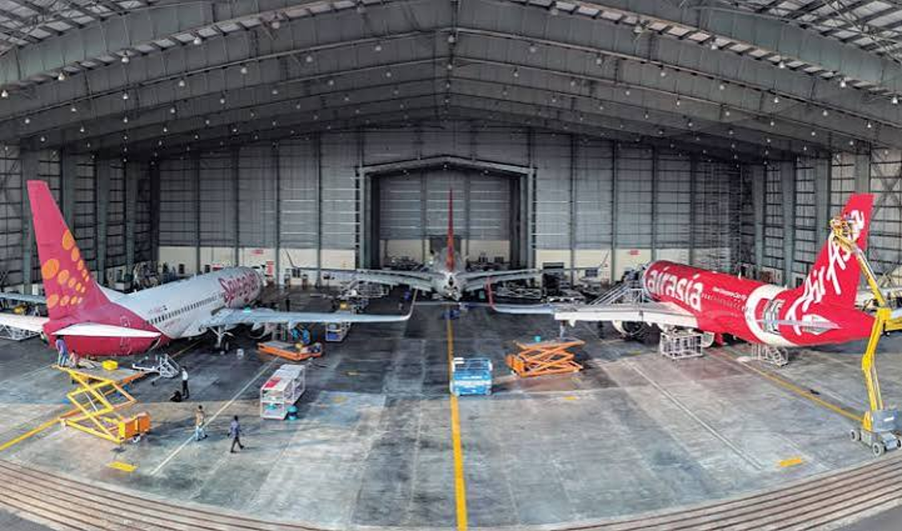
CAREER OUTLOOK
YOUR WORK KEEPS AIRCRAFT MOVING.
PROFESSIONAL ENVIRONMENTS
Commercial Airlines
Maintenance, Repair & Overhaul (MRO)
Civil Aviation Departments
Licensed Maintenance Roles
PATHWAY
Training → Exams → Practical / Type Training → Licence pathway
JHARKHAND FLYING INSTITUTE (AME) • VANOUR AIR PVT LTD
DHANBAD • JHARKHAND

Slide 9

LOCATION
09
TRAIN WHERE AVIATION HAPPENS.
DHANBAD AIRPORT
Barwadda Airstrip • Satyam Nagar / Kurmidih • Dhanbad, Jharkhand
AIRPORT-BASED TRAINING ECOSYSTEM
The uploaded brochure places the institute at Dhanbad Airport and describes an aviation-focused environment.
TYPE TRAINING & STATE PATHWAYS
The brochure describes type-training opportunities after Basic Training and potential pathways within state aviation organizations.
JHARKHAND FLYING INSTITUTE (AME) • VANOUR AIR PVT LTD
DHANBAD • JHARKHAND

Slide 10
LEADERSHIP
10
EXPERIENCE THAT CONNECTS CLASSROOM TO AVIATION.
CAPT. S.P. SINHA
Prominent aviator and entrepreneur associated with Jharkhand State aviation and the initiative.
MR. SHIVRAJ KUMAR
30+ years of civil aviation experience spanning flying clubs, major airlines and defence projects; multi-rating AME licences.
CAPT. (RTD) LAXMAN SINGH
30+ years of defence service; the brochure highlights his focus on empowering talented students from smaller towns and rural backgrounds.
VETERAN CIVIL AVIATION PROFESSIONALS
JHARKHAND FLYING INSTITUTE (AME) • VANOUR AIR PVT LTD
DHANBAD • JHARKHAND

Slide 11
JFI + VANOUR AIR
A PARTNERSHIP BUILT AROUND AVIATION TRAINING.
The uploaded brochure identifies Jharkhand Flying Institute (AME) as a Joint Venture with Vanour Air Pvt Ltd and lists the following official admission contacts.
PHONE / WHATSAPP
EMAIL
+91 9595242501
vanour@vanourair.com
WEBSITE
ADDRESS
https://vanourair.com
Dhanbad Airport, Bhuli Hirak Road, Satyam Nagar, Dhanbad, Jharkhand – 826010
OFFICIAL-INFORMATION HIGHLIGHTS
DGCA CAR-147 Basic Approved AME College • MRO-base practical exposure • Modern labs & workshops • Vanour Air: 30+ years of aviation experience (as stated in the uploaded brochure)
JHARKHAND FLYING INSTITUTE (AME) • VANOUR AIR PVT LTD
DHANBAD • JHARKHAND

Slide 12
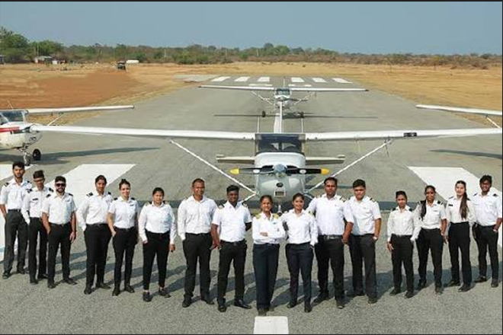
READY TO ENTER
THE WORLD OF
AVIATION ENGINEERING?
B1.2 • B2 • COMBINED • TYPE TRAINING
JHARKHAND FLYING INSTITUTE (AME)
+91 9595242501
vanour@vanourair.com
https://vanourair.com
ADMISSIONS & PROGRAMME INFORMATION

